Slide 1

Data Analysis Using Tableau
Bhagyashree More
Enrollment ID-EN12024077896

Slide 2

Objective
Analyze the customers data of a North American bank and build an interactive dashboard using Tableau.
Building a dashboard using Tableau. Building a dashboard will involve analyzing the data and presenting the result using appropriate charts/graphs.

Slide 3
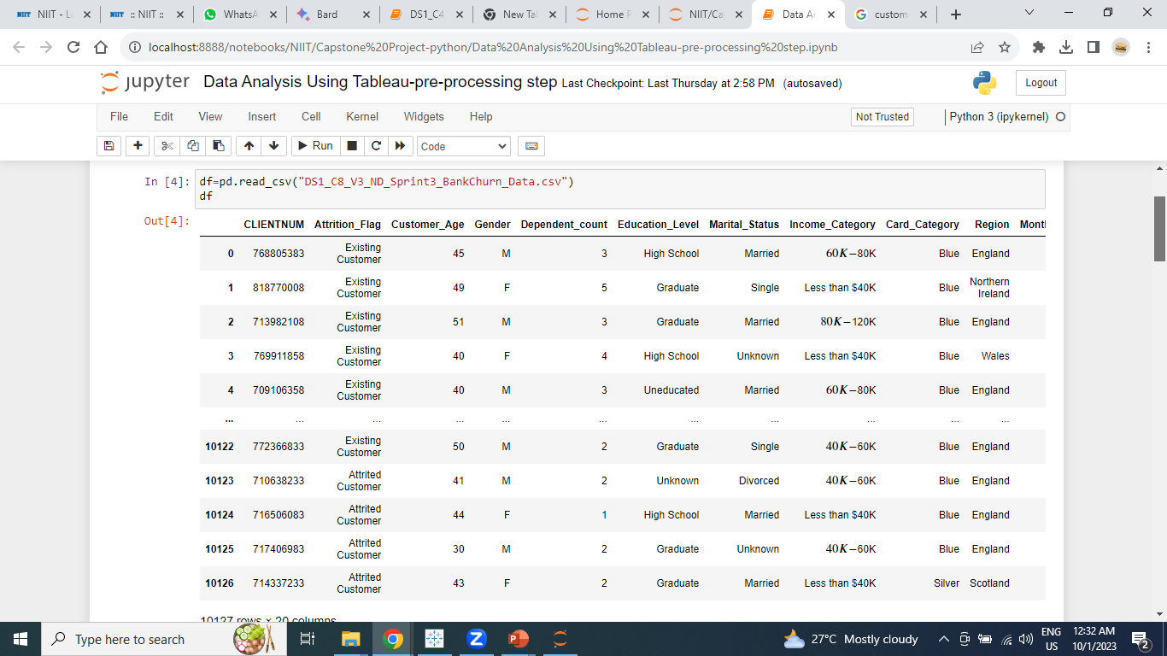
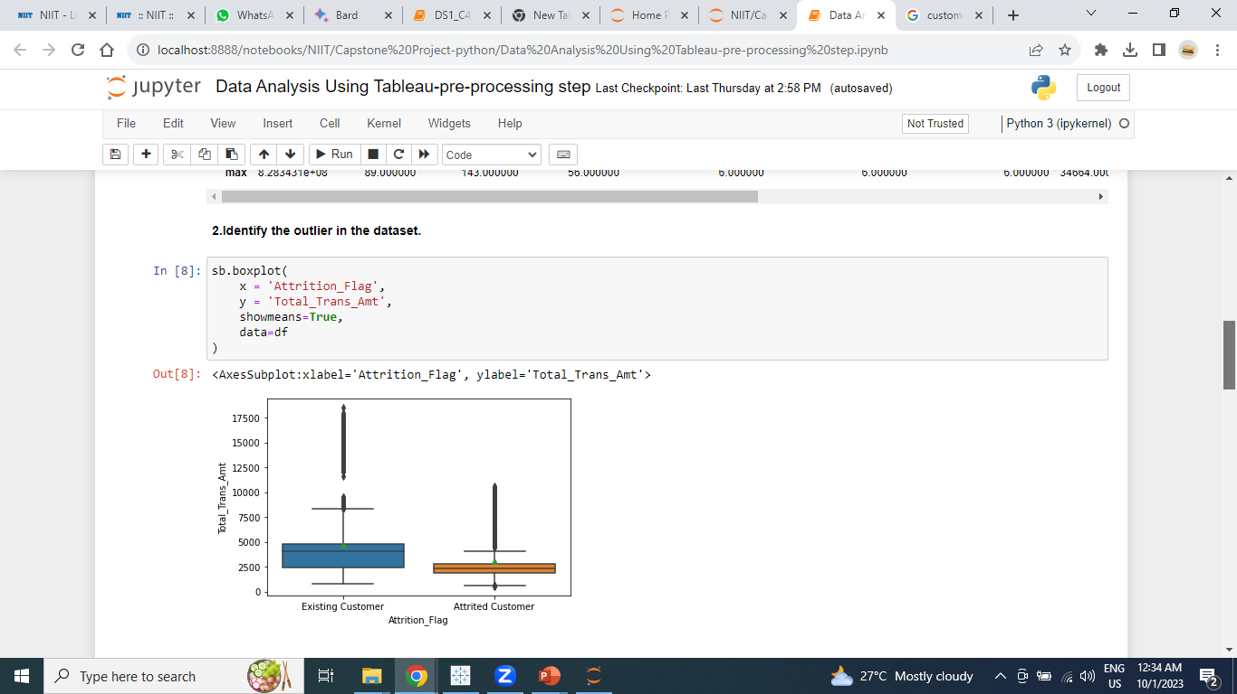
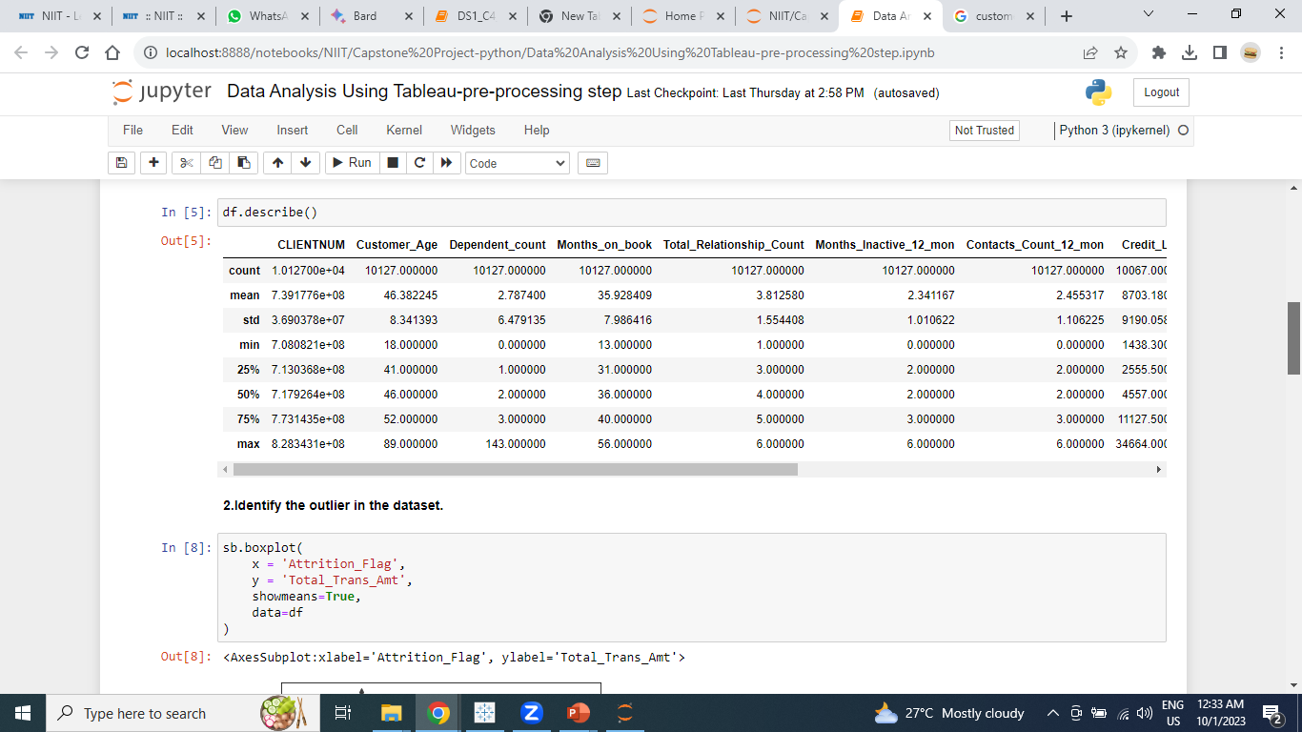
Data Pre-processing using python

Slide 4
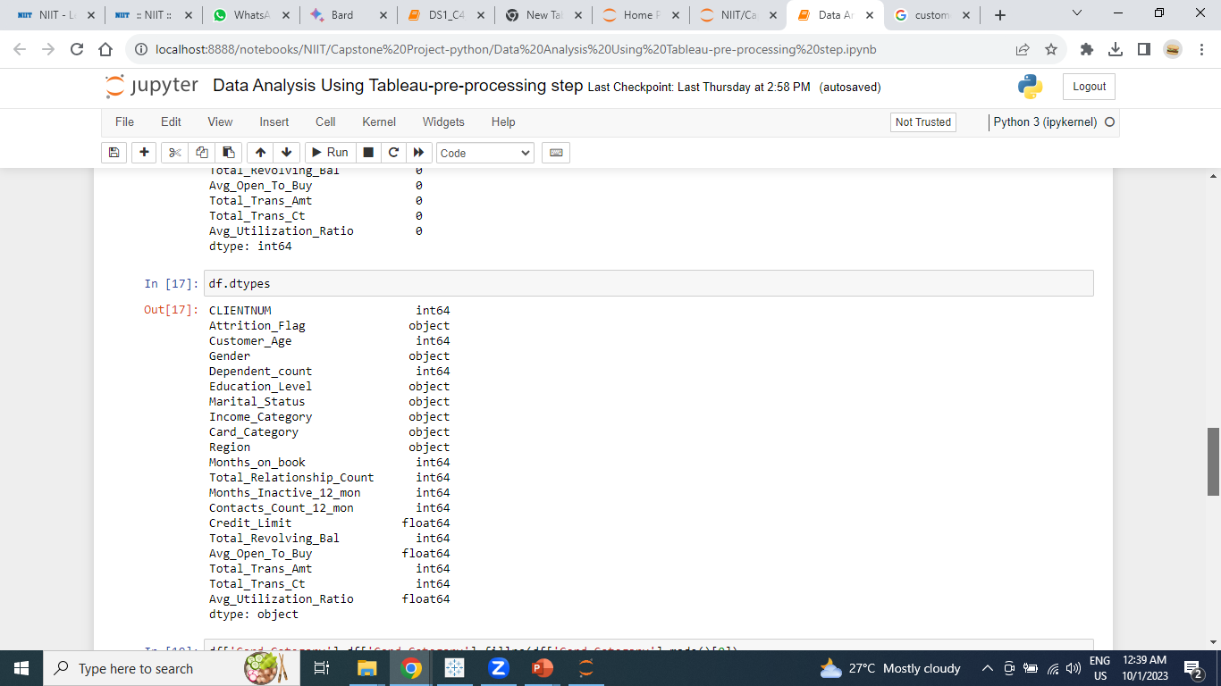
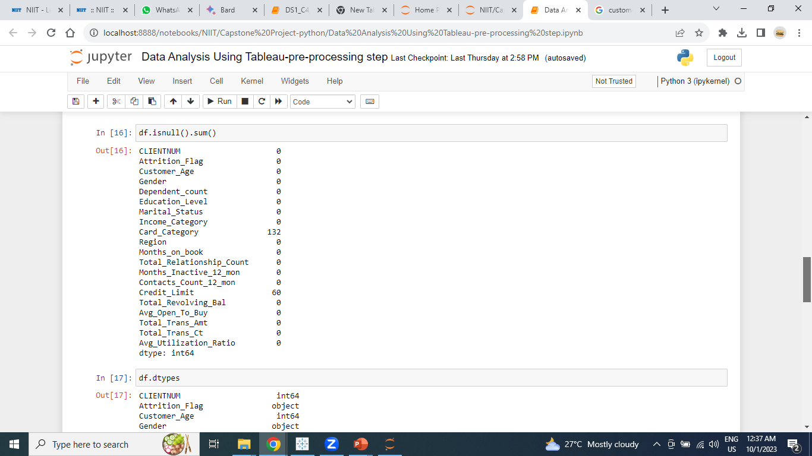
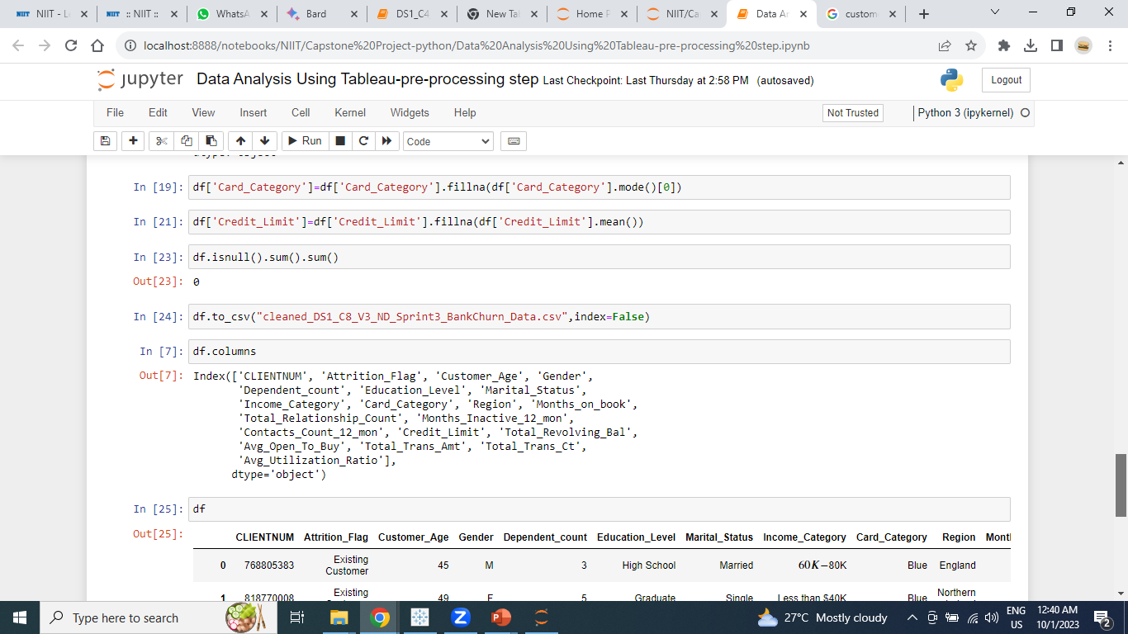

Slide 5
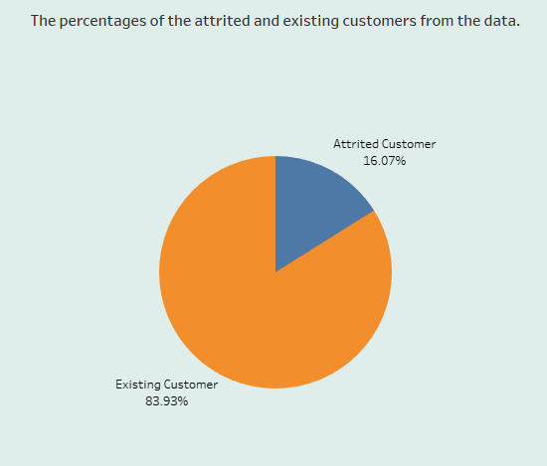
Task 1: Display the percentage of the attired and the existing customers from the data
Conclusion: Existing customers are 83.93% and Attired customers are 16.07%

Slide 6
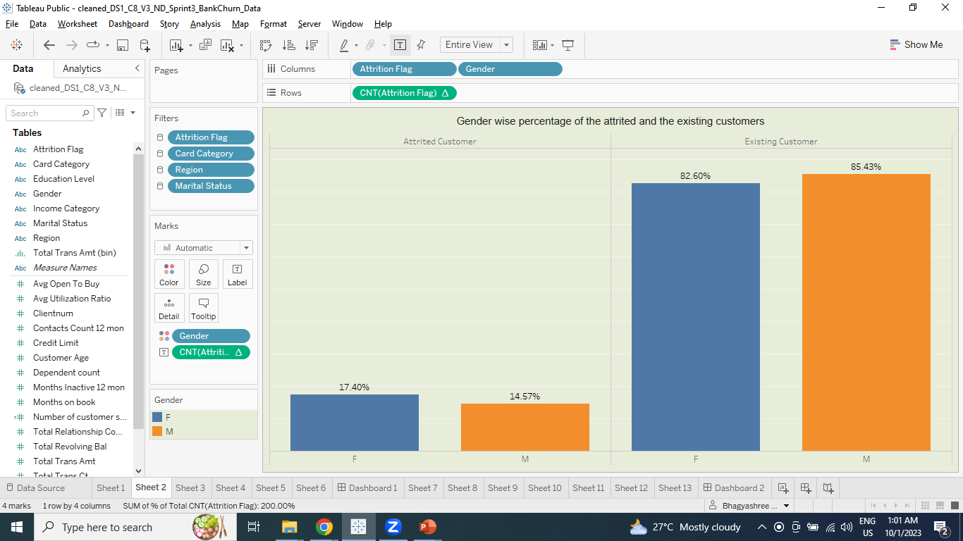
Task 2: Display gender-wise percentage of the attired and the existing customers.
Conclusion: Existing customers in Female 82.60% and males 85.43% and Attired customers in Female 17.40% and Male 14.57%

Slide 7
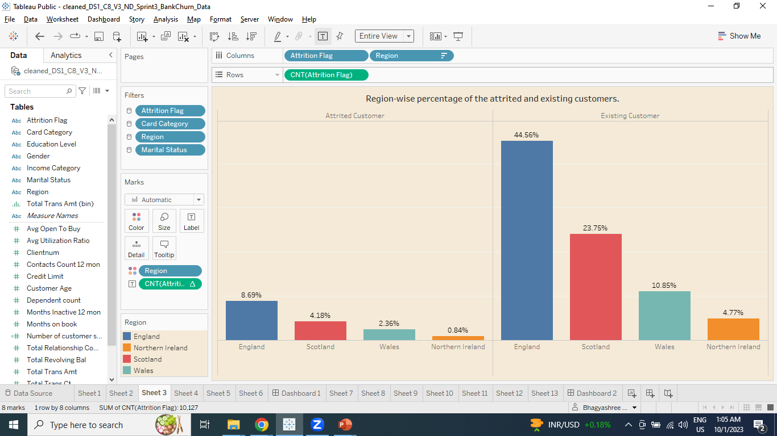
Task 3: Display region-wise percentage of the attired and the existing customers.
Conclusion: Existing customers in England 44.56%,Scotland 23.75%,wales 10.85 and northern 4.77%, In Attired customers in England 8.69%,Scotland 4.18%,wales 2.36 and northern 0.84%

Slide 8
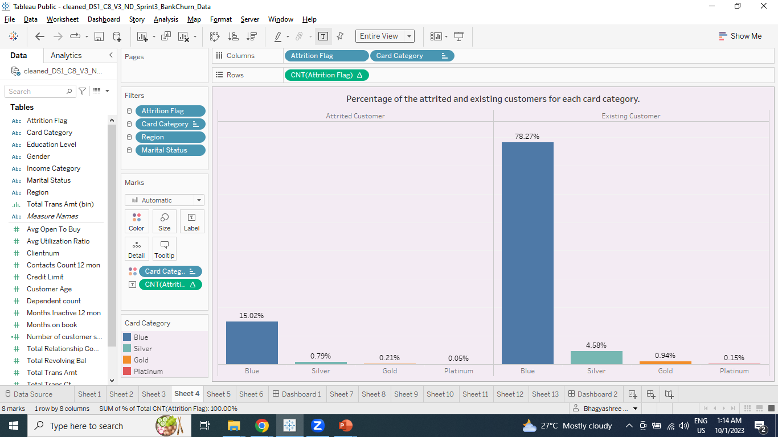
Task 4: Display percentage of the attired and the existing customers for each card category.
Conclusion: Existing customers in blue card 78.27%,silver 4.58%,gold 0.94% and platinum 0.15% In Attired customers in blue card 15.02%,silver 0.79%,gold 0.21% and platinum 0.05%

Slide 9
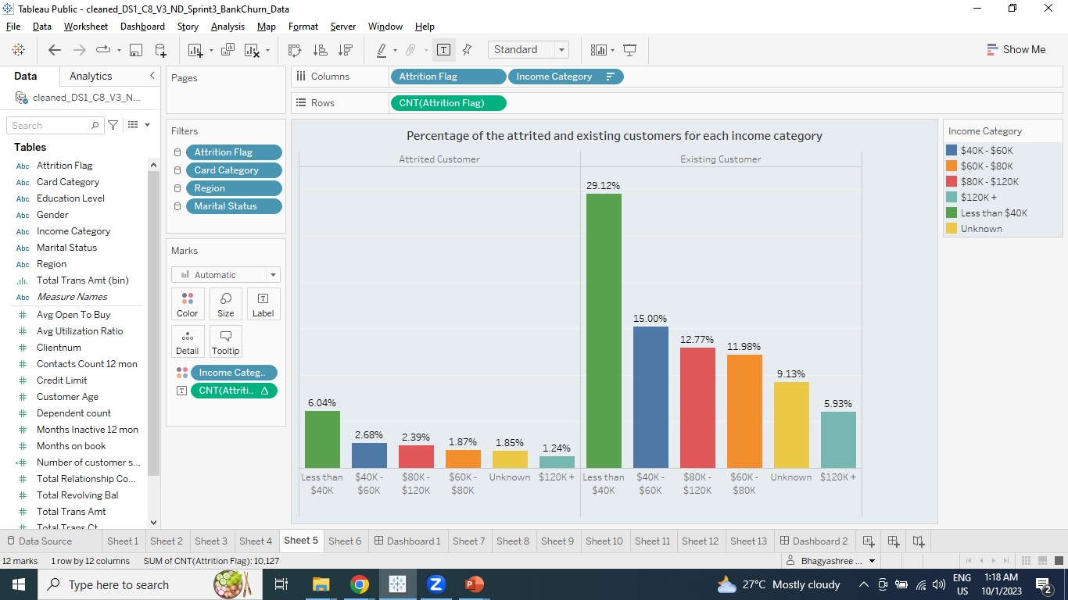
Task 5: Display percentage of the attired and the existing customers for each Income category.
Conclusion: Existing customers income category is 29.12% less than $40k, In Attired income category is 6.04% less than $40k

Slide 10
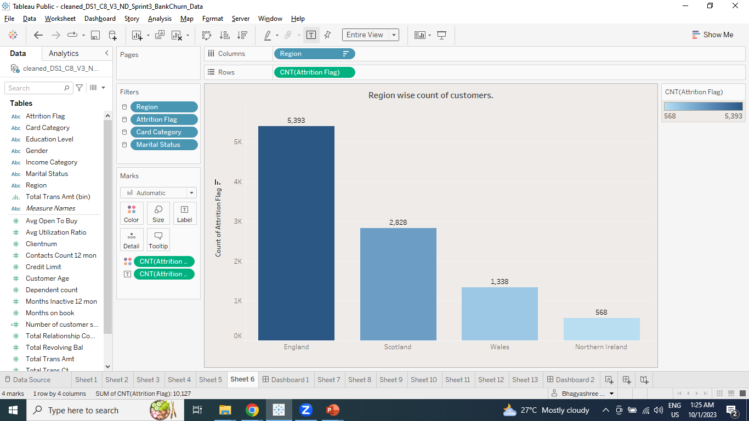
Task 6: Display region-wise count of customers. identify the region that has maximum number of customers.
Conclusion: England region that has maximum number of customers.

Slide 11
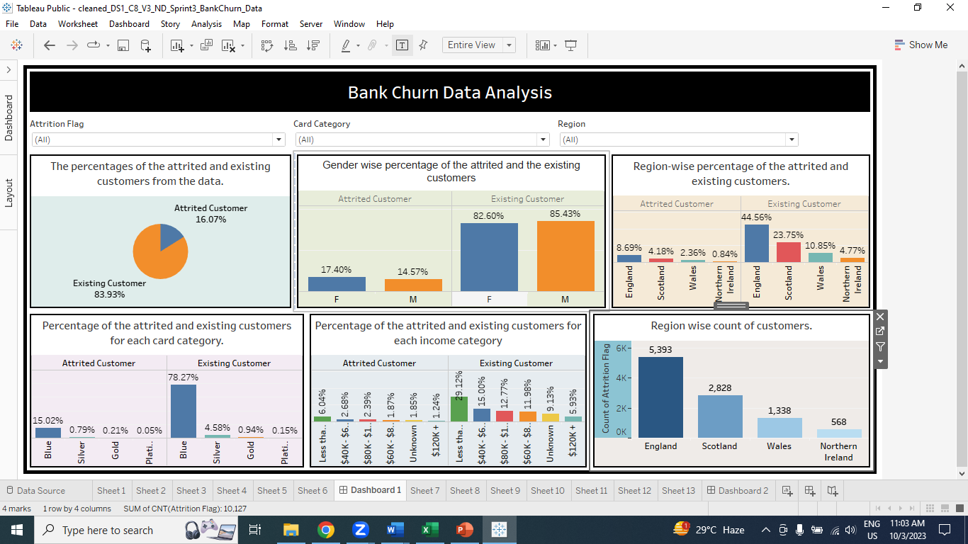

Slide 12
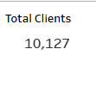
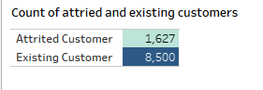
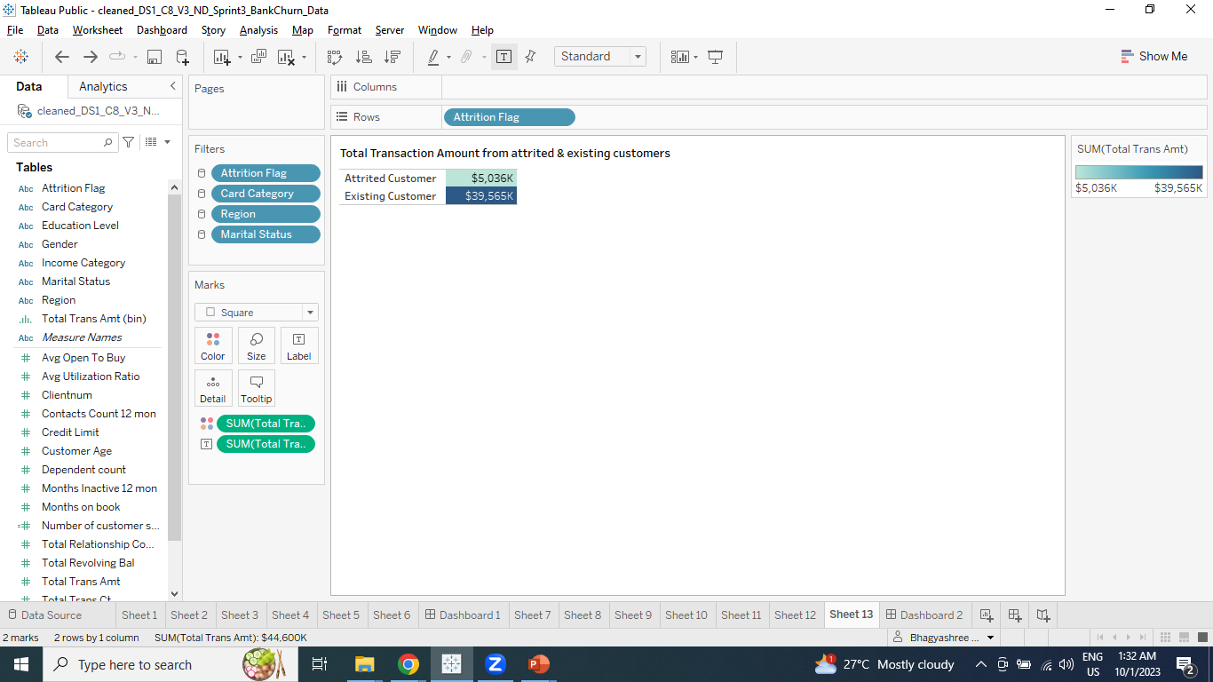
Task 7: Display total number of customers, count of attired and existing customers. Total Transaction Amount from attired & existing customers.
Conclusion: England region that has maximum number of customers.

Slide 13
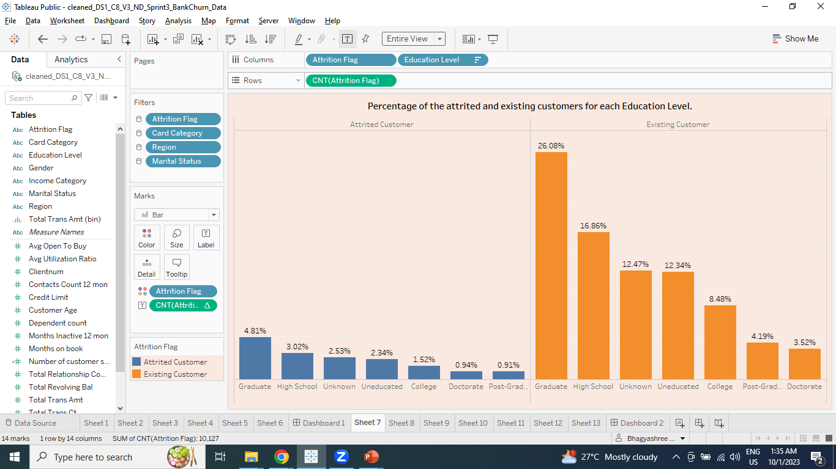
Task 8: Display percentage of the attired and the existing customers for each Education Level.
Conclusion: Attired customers and Existing customers are graduate.

Slide 14
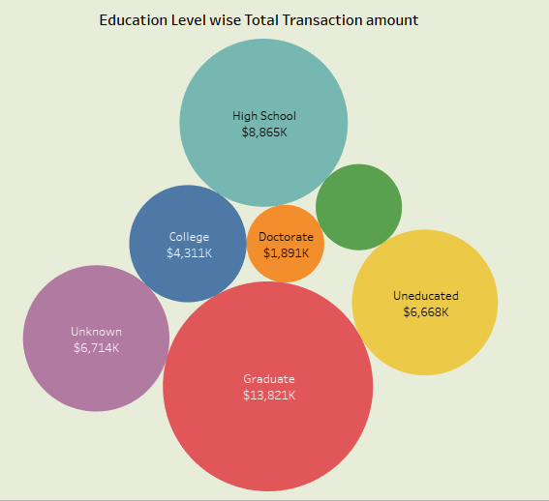
Task 9: Display Education level wise total Transaction amount
Conclusion: Graduate customers do more transaction.

Slide 15
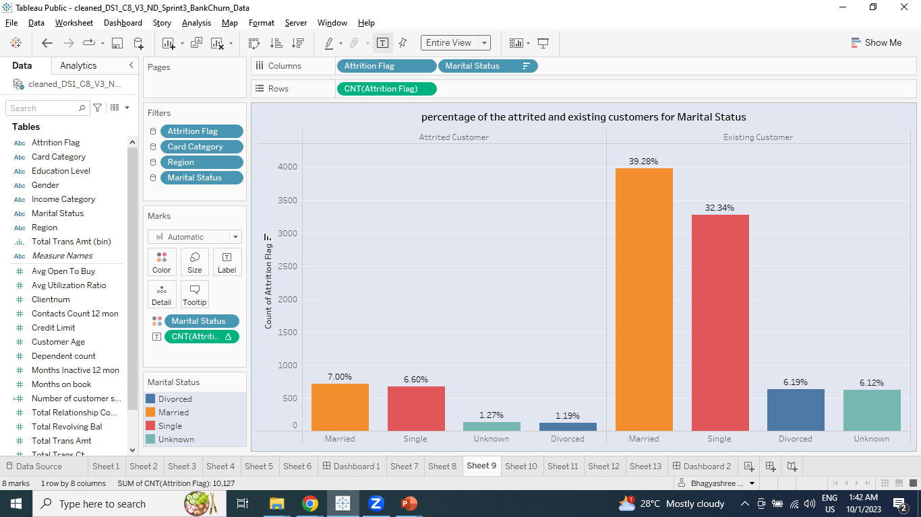
Task 10: Display percentage of the attired and the existing customers for Marital Status.
Conclusion: 46% attired and the existing customers are married.

Slide 16
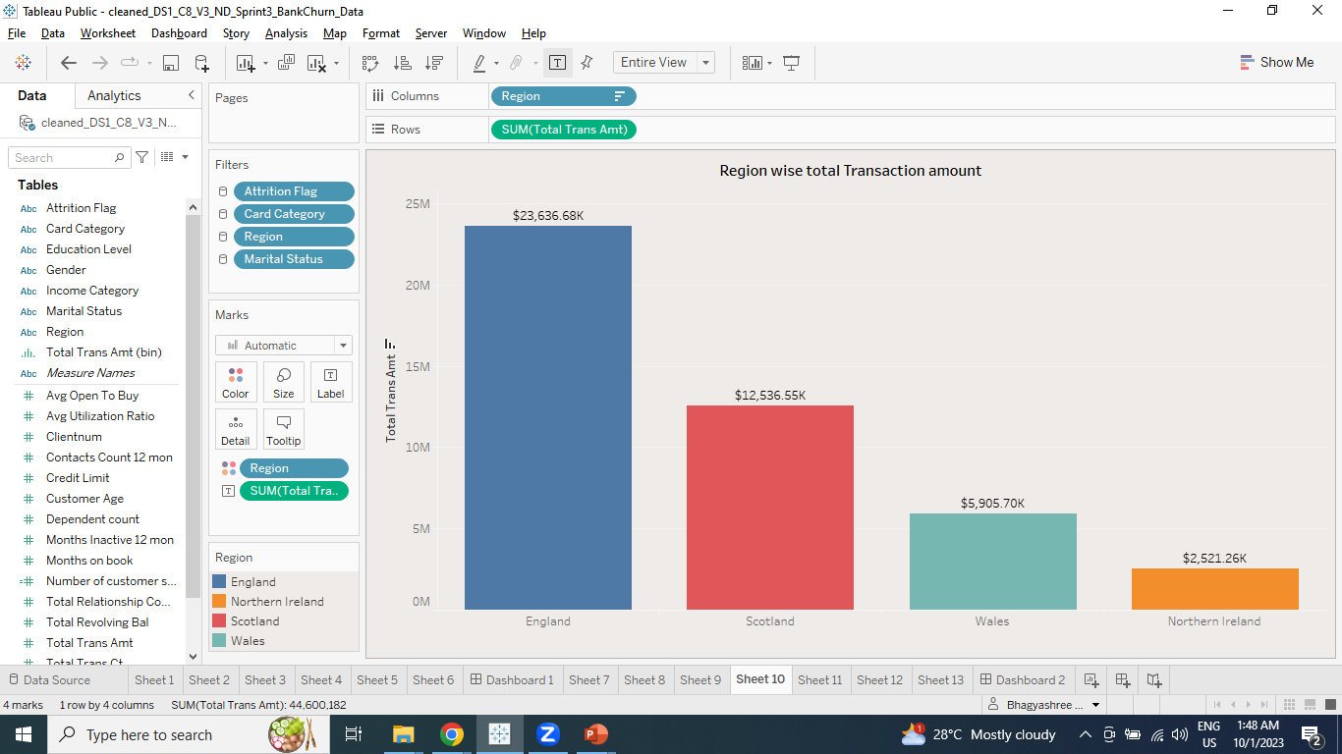
Task 11: Display Region wise total Transaction amount
Conclusion: In England region have more Transaction amount.

Slide 17
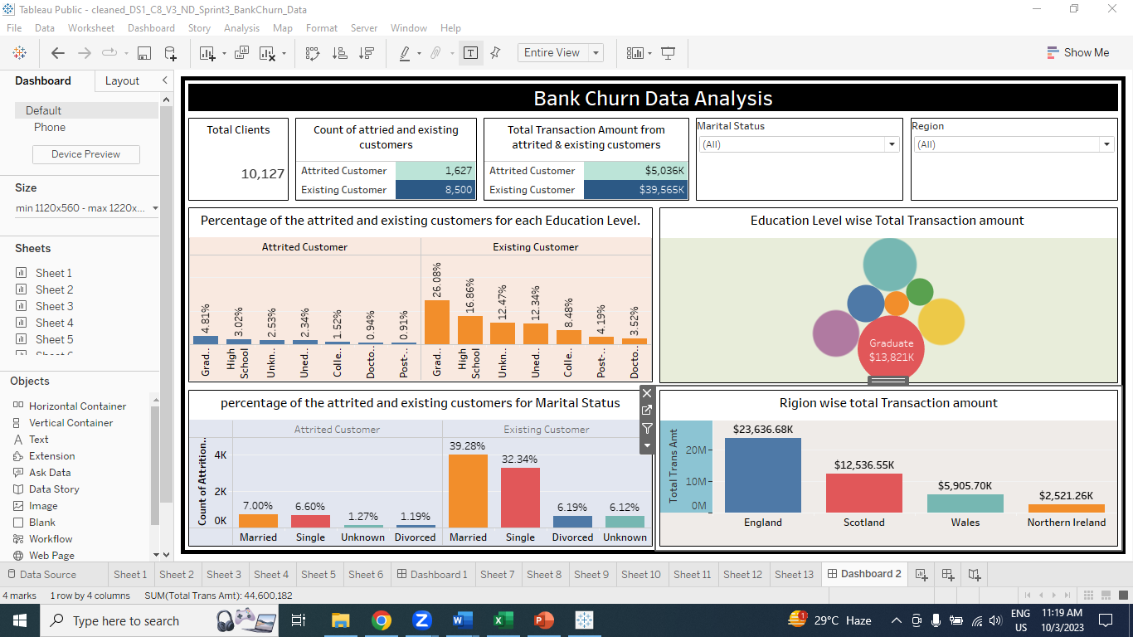

Slide 18

Conclusion
Existing customers are more valuable to the company than attired customers.
Existing customers are more likely to be female, have a higher income, and have a blue card.
They are also more likely to be graduates and do more transactions.
Additionally, the England region has the highest transaction amount, suggesting that there is an opportunity to focus on acquiring and retaining customers in this region.

Slide 19
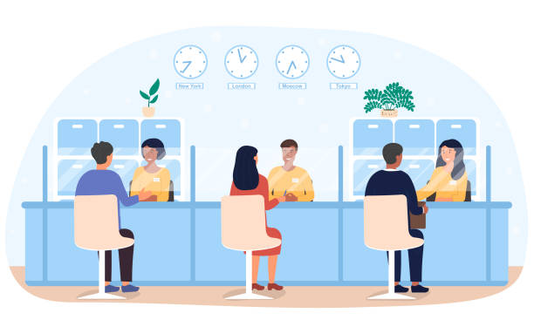
A strategy to Increasing Revenue
1. Focus on retaining existing customer.
2. Focus on retaining existing customers.
3. Offer products and services that appeal to graduate customers.
4. Partner with other businesses that target the same customer segments.

Slide 20
Thank You

